Slide 1
Germitec Presentation
2019
Easy and ultrafast HLD ultrasound probe

Slide 2
One concern : HAI via Ultrasound examination
Cardiology
Anesthesiology
Obstetrics /Gynecology
Urology
Emergency
Biopsies
Probes Contamination ???

Slide 3
Endocavitary Ultrasound Probes have to be HLD
PROBE USAGE | RISK | DISINFECTION | EFFICACY
contact with sterile tissue or vascular system (eg: prostate biopsie) | Critical | Sterilisation, if not possible High Level Disinfection | HLD = ILD + Sporicidie
contact membranes muqueuses (ex: œsophages ou peau non intact) | Semi-Critical | High Level Disinfection HLD | Bactericide, Fungicide, Mycobacteria, Virus
contact avec peau intact | Non-Critical | Low Level Disinfection LLD | Bactericide
Spaulding Classification

Slide 4
Pressure towards HLD for Probes Worldwide
Regulatory Bodies
HLD required
Medical Societies
Regulations
Guidelines
Compulsory in the USA , Canada , Australia,..
Recent guidelines in Scotland , Ireland , Wales, Israel,…
Project in progress in F , GB et Germany
=>Systematic HLD between each patient
WFUMB (World Federation of Ultrasound in Medicine and Biology) in Sept
ESR ( European Society of Radiology ) in Nov 2017
=> Systematic HLD between each patient

Slide 5
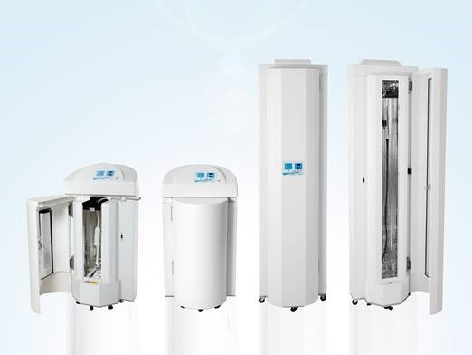
In a nutshell | Disruptive High-Level Disinfection (HLD) technology
Germitec at a glance
Strong technological adoption
Germitec has created Antigermix, a breakthrough HLD technology based on photon instead of chemicals.
Expected turnover in 2018e
140 units sold (+63% YoY)
# countries where Germitec has regulatory approval
20+
€2M
Antigermix AS1
For external, vaginal (TV) & rectal (TR)
ultrasound probes
Installed unit base as of H1 2018
Filed patents focusing in UV disinfection technology
530+
12+
HLD is becoming the global disinfection standard. Germitec is on track to conquer a nascent €2.5B+ worldwide market.
Antigermix AE1
For transesophageal ultrasound probes
Hit 50%+ market share globally and become the international standard for High-Level Disinfection.

Slide 6
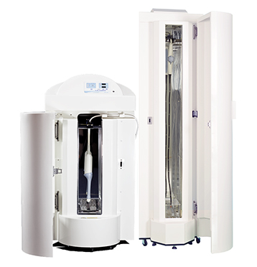
Solution | Antigermix platform sets the next-gen HLD standards
Key advantages
Antigermix platform
Using photons, Germitec has developed a breakthrough technology offering
1. Full compliance to HLD standards
Strong IP backed by 12+ patents
2. Seamless to workflow solution
Praised by users & recognized Key Opinion Leaders worldwide
Preferred and pushed by public authorities
AE1
TIME &
COST-SAVING
AS1
FULLY-AUTOMATED
SAFE
SOLUTION
ENVIRONMENTALLY FRIENDLY
FULL
TRACEABILITY

Slide 7
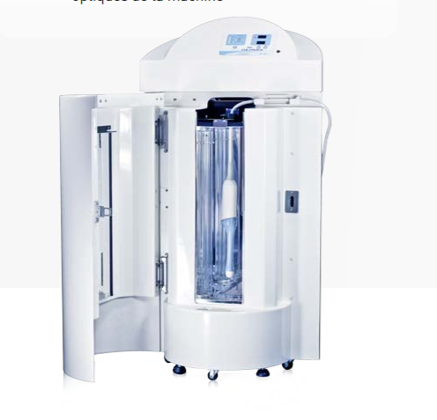
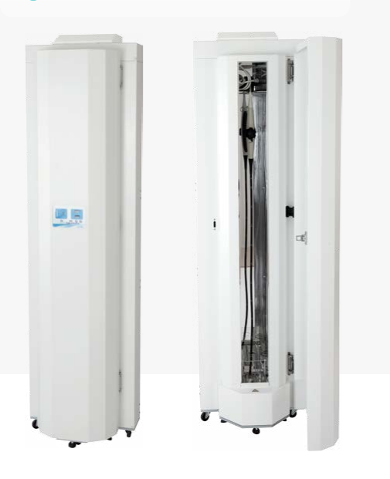
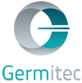
USP | Antigermix is faster & more efficient than other solutions
Antigermix is radically faster
than other HLD
Germitec is the first player to offer user friendly and seamless to workflow disinfecting platform for ultrasound probes
Antigermix As1: external, vaginal and rectal probe
ULTRA-FAST
CLEAN UVC PROCESS
easy
Compliance
Full disinfection 10 - 20x faster than other HLD
90 sec
14 minutes
Simple and 100% automated solution
Safe process for doctors and patients - no chemicals
Seamless solution
Full automated traceability
30 minutes
Other HLD
Germitec solves the economic equation for disinfection
Antigermix aE1: transesophageal echocardiogram probe
Full disinfection 10x faster than other HLD
3 minutes
5x increase in the number of examinations
3x increase in life expectancy of probes
30 minutes
Other HLD

Slide 8
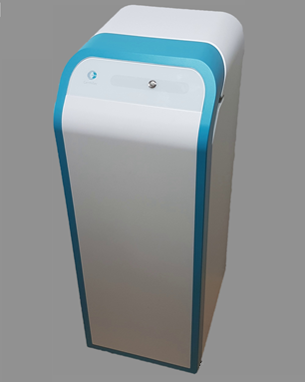
Latest developpement
2019

